Slide 1
Honors Scholarships Workshop

Slide 2
Some warm-up questions

Slide 10
Should I apply?
I’m intimidated!
Is it competitive?
It’s too much effort.

Slide 11
Let’s demystify the process

Slide 12
Types of Honors Scholarships
Honors Scholarships
Honors Stipend
National Scholarships...

Slide 13
National Scholarships
Now under the purview of director Angela Deaver-Campbell
Please refer to the Scholarship Resource Center for more info:
http://www.scholarshipcenter.ucla.edu/

Slide 14
Summer Stipend
Research ( library, laboratory, and/or field-based )
Awards of $1,000, and an additional $500 for the outstanding proposal, ~20 awards given
Due around April
Need professor to sponsor
Perfect for Departmental Honors students
Eligible students: College Honors, Departmental Honors, and Departmental Scholar Students
1. Application Form
2. Agreement Form
3. A typed Research Proposal (please read instructions on the Agreement Form)
4. A typed brief paragraph describing yourself (your major, your research interests, your future plans, etc.) in 70 words or less

Slide 15
Honors Scholarships
Reserved for honors students
Who reads applications?
How do I receive the $$?
Deadline: Friday, April 3 at 11:59 pm...Opens March 21st,

Slide 17
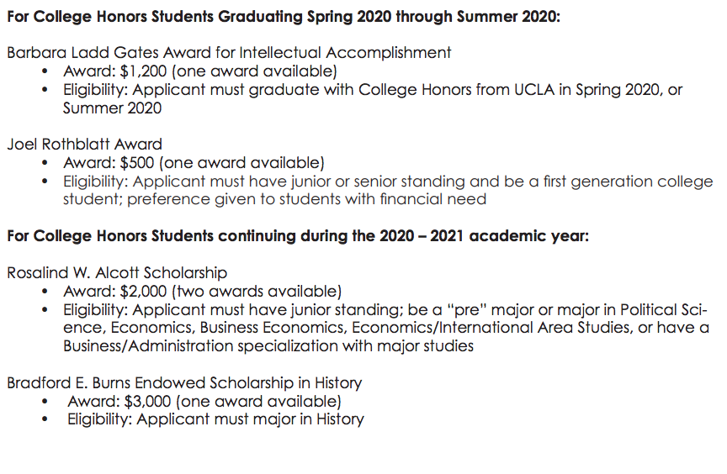
Different Types of Scholarships Available

Slide 18
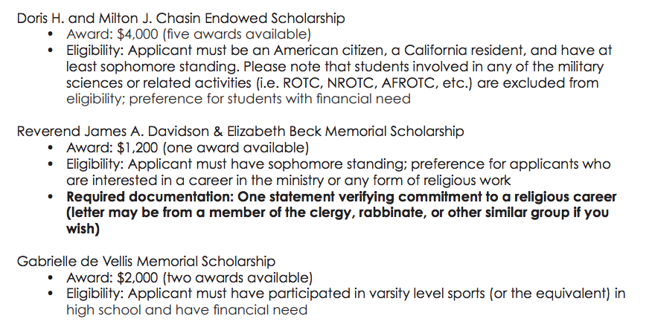

Slide 19
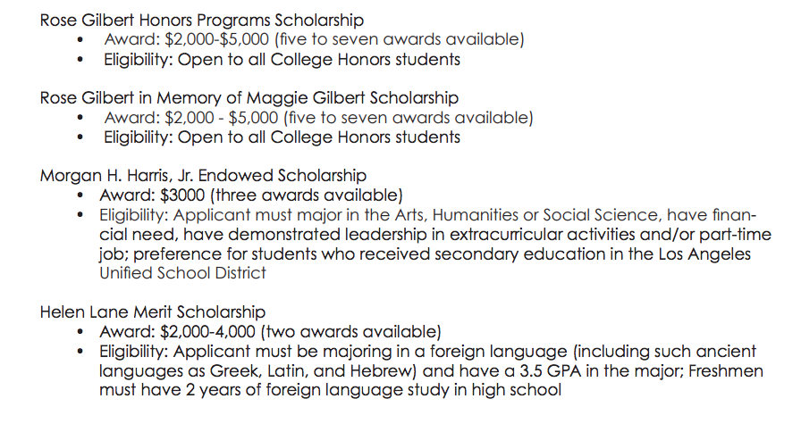

Slide 20
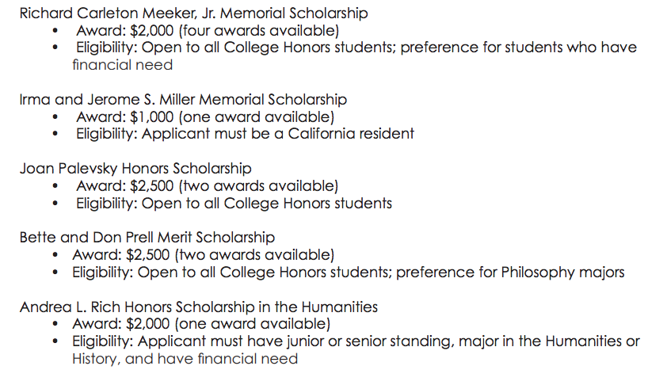

Slide 21
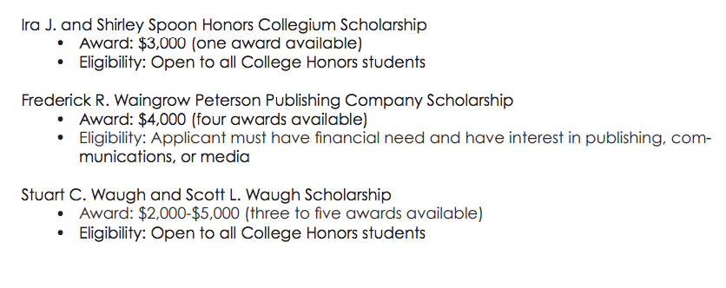

Slide 22
Components of Honors Scholarships Application
Main parts:
1. General application: basic information (make sure there are no errors!)
2. General application (cont.): Extracurricular Activities and Volunteer Work, Research, Honors and Awards
3. Personal Statement
4. Prompt Response
5. Supplemental Information: if required

Slide 23
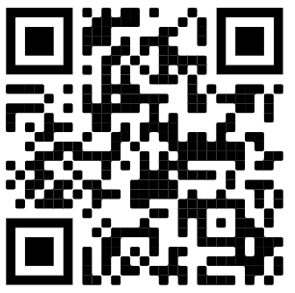
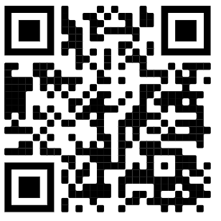
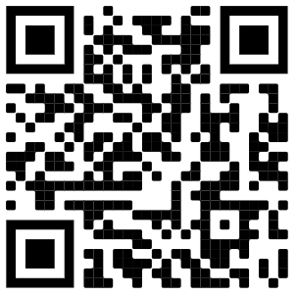
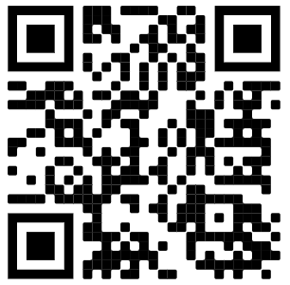
Activities, Honors, etc
Can you put high school activities?
Tips for a polished resume
Use action verbs and be descriptive
Helpful online resources:
UCLA Career Center
UC Berkeley Career Center
Luskin School
UCLA Career Guide
UCLA Career Center Online Resume Workshop
Luskin Resume Tips and Samples
UCLA Career Guide
UCB Career Center Online Resume Help

Slide 24
Instead of: "Organized all sorority philanthropic events."
Write this: "Organized all sorority philanthropic events which resulted in contributions of over $4000."

Slide 25
Building your bullet points

Slide 26
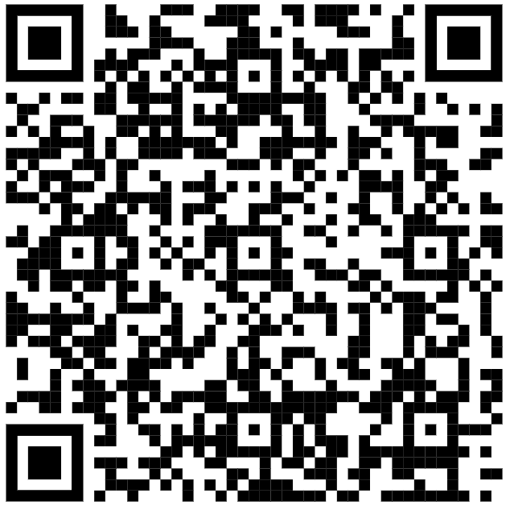
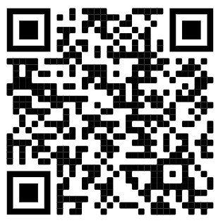
Personal Statement and Prompt Response
Very important!
Writing Center Online Resources
5 ways to make your scholarship essay stand out

Slide 27
Personal Statement
Write a personal statement that describes your background, personal interests, and your educational and career goals (500 words maximum).

Slide 28
Prompt Response
In his Ted Talk, Are you a Giver or a Taker, organizational psychologist Adam Grant discusses three personality types in the workplace and offers simple strategies to promote a culture of generosity at work. What thoughts/considerations do you have about the content of this Ted Talk? Feel free to respond to this question with either an essay, a 1-3 minute video, or an infographic.
Guidelines for the three options: 1. Essay – double-spaced, 12 pt. standard font (e.g. Times New Roman), 500 word maximum 2. Infographic - minimum recommended size is 800 x 1800 pixels, 300 DPI for potential print in png format or jpg 3. Video – 3 minutes max, uploaded to youtube, vimeo, google drive, box, or any accessible domain of your choice. Include a link and please ensure that it is viewable to anyone who receives the link.

Slide 29
Advice
BE GENUINE
Be creative: But make sure it’s understandable, and avoid confusion
Proofread
It’s a personal statement, not a cover letter. Don’t reiterate your activities!
Don’t recycle from other scholarship applications

Slide 30
Questions?

Slide 31
Feedback
https://tinyurl.com/t7v6j8q

